Slide 1


By-Jahanvi

Slide 2
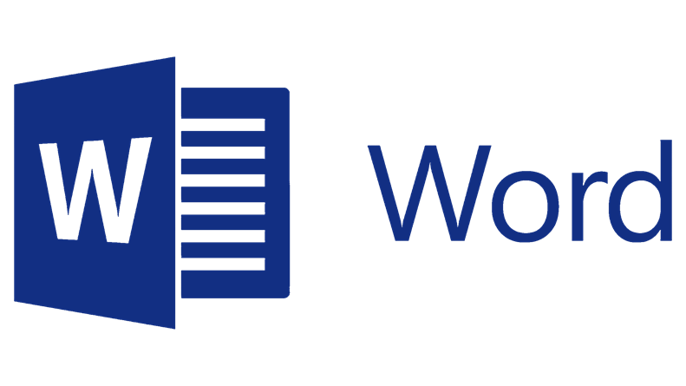
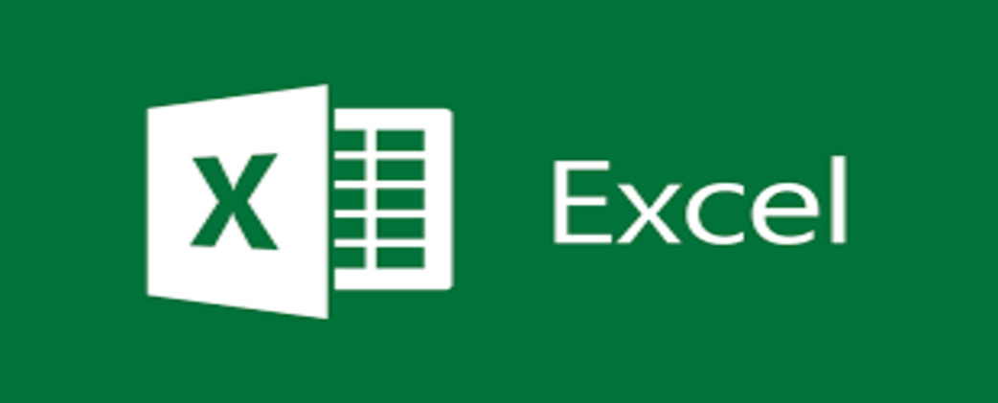

Products
Microsoft Word
Microsoft Excel
Microsoft PowerPoint

Slide 3
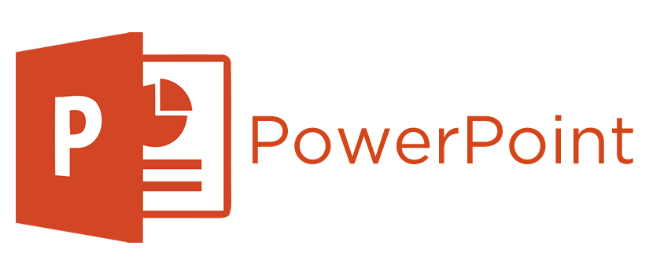
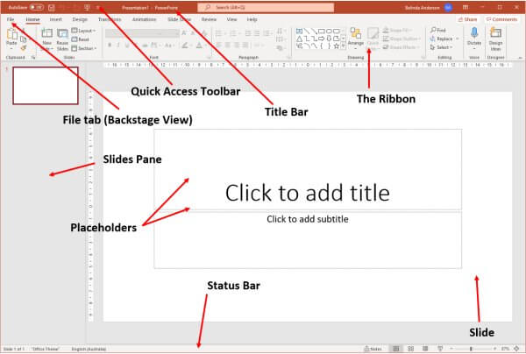
MS PowerPoint
Microsoft PowerPoint is a presentation program, created by Robert Gaskins and Dennis Austin at a software company named Forethought, Inc. It was released on April 20, 1987, initially for Macintosh computers only. Microsoft acquired PowerPoint for about $14 million three months after it appeared. Microsoft PowerPoint is a powerful slide show presentation program. It is a standard component of the company's Microsoft Office suite software, and is bundled together with Word, Excel, and other office productivity tools. The program uses slides to convey information rich in multimedia. With PowerPoint on your PC, Mac, or mobile device, you can: Create presentations from scratch or a template. Add text, images, art, and videos. Select a professional design with PowerPoint Designer.

Slide 4
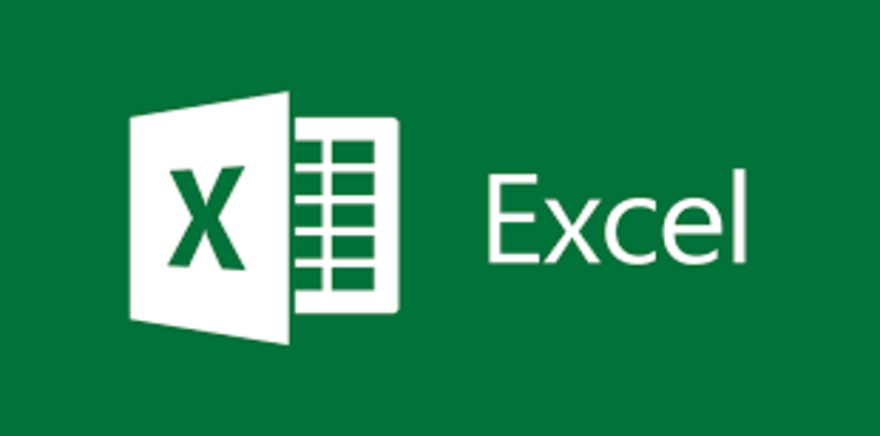
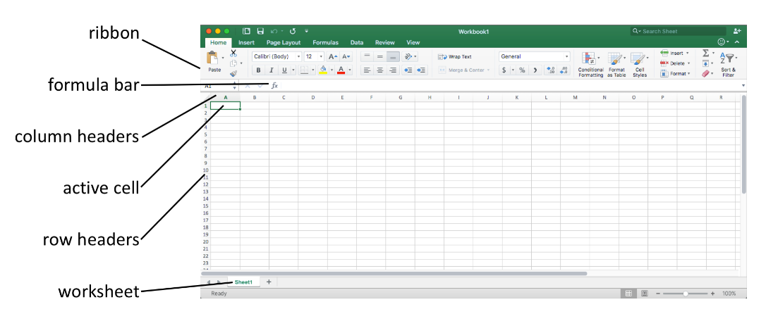
MS Excel
Microsoft Excel is a spreadsheet developed by Microsoft for Windows, macOS, Android and iOS. It features calculation or computation capabilities, graphing tools, pivot tables, and a macro programming language called Visual Basic for Applications. Excel forms part of the Microsoft Office suite of software. Excel is a spreadsheet program from Microsoft and a component of its Office product group for business applications. Microsoft Excel enables users to format, organize and calculate data in a spreadsheet. By organizing data using software like Excel, data analysts and other users can make information easier to view as data is added or changed. Excel contains a large number of boxes called cells that are ordered in rows and columns. Data is placed in these cells.
Excel is a part of the Microsoft Office and Office 365 suites and is compatible with other applications in the Office suite.
Excel has its own terminology for its components, which new users may not immediately find understandable.

Slide 5
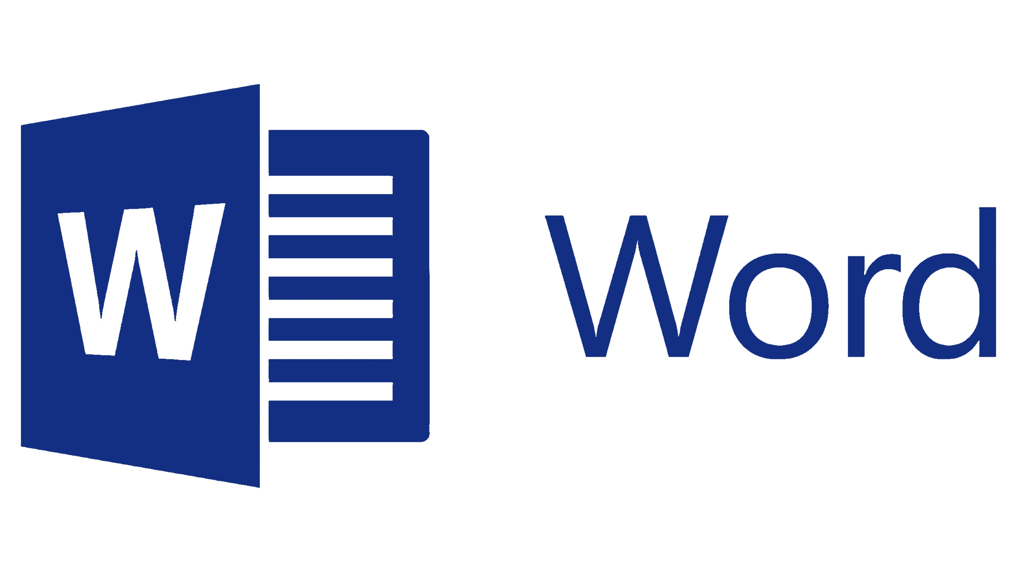
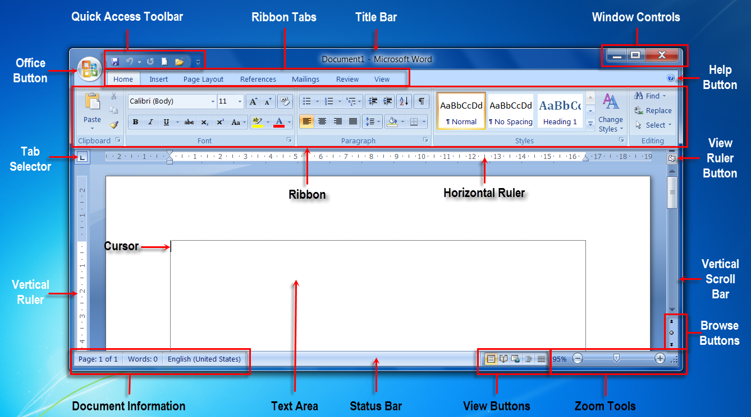
MS Word
Microsoft Word is a word processing software developed by Microsoft. It was first released on October 25, 1983, under the name Multi-Tool Word for Xenix systems. Used to make professional-quality documents, letters, reports, etc., MS Word is a word processor developed by Microsoft. It has advanced features which allow you to format and edit your files and documents in the best possible way. Subsequent versions were later written for several other platforms including: IBM PCs running DOS (1983), Apple Macintosh running the Classic Mac OS (1985), AT&T UNIX PC (1985), Atari ST (1988), OS/2 (1989), Microsoft Windows (1989), SCO Unix (1990) and macOS (2001). Using Wine, versions of Microsoft Word before 2013 can be run on Linux.
Commercial versions of Word are licensed as a standalone product or as a component of Microsoft Office suite of software, which can be purchased either with a perpetual license or as part of a Microsoft 365 subscription.

Slide 6


